Slide 1
*7 reasons for ssr

Slide 2
1. Kids who read often get better at it

Slide 3
Practice makes perfect in almost everything we do, and reading is no different from other activities.

Slide 4
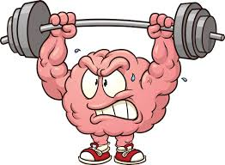
2. Reading exercises our brains and improves concentration

Slide 5
Reading strengthens brain connections and actually builds new connections.

Slide 6
3. Reading teaches students about the world around them.

Slide 7
Through reading, we learn about people, places and events outside our own experience. We are exposed to ways of life, ideas and beliefs about the world which may be different from those around us.

Slide 8
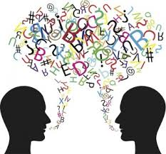
4. Reading improves a student’s vocabulary and leads to more highly-developed language skills.

Slide 9
This is because students learn new words as they read, and they unconsciously absorb information such as how to structure sentences and how to use words and language effectively.

Slide 10
5. Reading develops a student’s imagination.

Slide 11
This is because when we read, our brains translate the descriptions of people, places and things into pictures. When we’re engaged in a story, we’re also imagining how the characters are feeling. We use our own experiences to imagine how we would feel in the same situation.

Slide 12
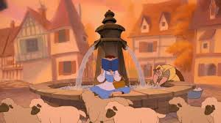
6. Reading relaxes the body and calms the mind.

Slide 13
The constant movement, flashing lights and noise which bombard our senses when we’re watching TV, looking at a computer or playing an electronic game are actually quite stressful for our brains.

Slide 14
When we read, we read in silence and the black print on a white page is much less stressful for our eyes and brains.

Slide 15
7. Students choose what they read.

Slide 16
The best part of SSR is that students get to select their own books and choose what they want to read.

