Slide 1
SAT Mystery Pictures
Lesson 1-4

Slide 2
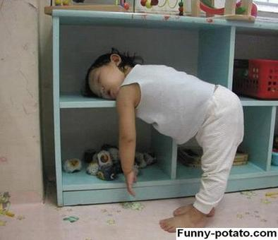
1

Slide 3
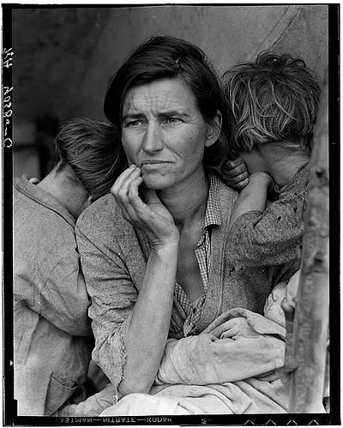
2

Slide 4
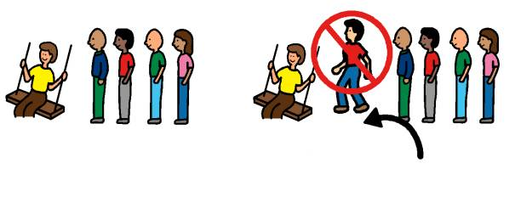
3
Hey! That’s not fair! He cut the line!

Slide 5
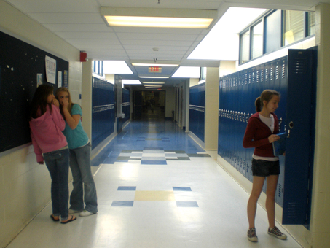
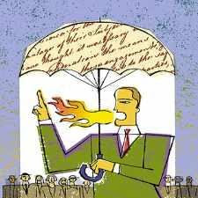
4

Slide 6
5

Slide 7
6

Slide 8
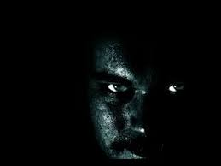

Slide 9
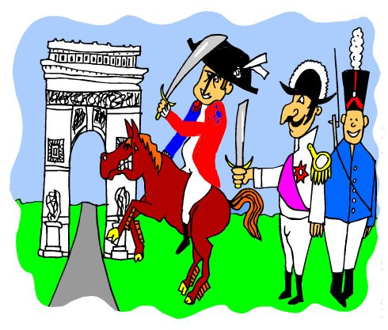
7

Slide 10
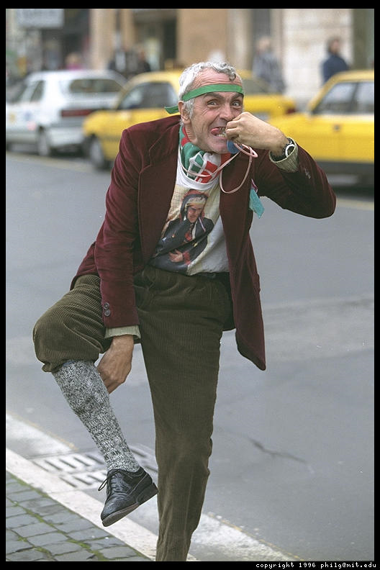
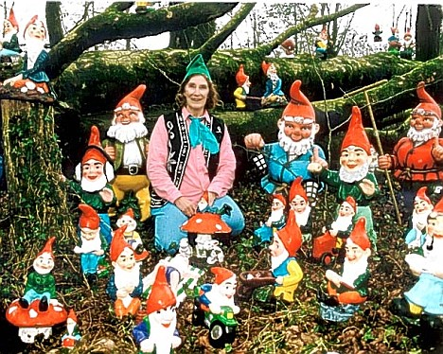
8

Slide 11
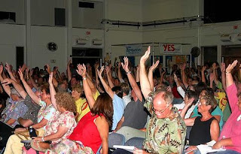
9

Slide 13
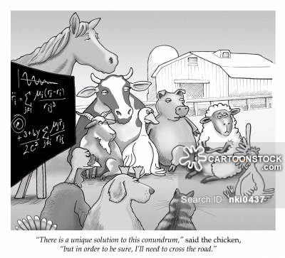
http://www.cnstockphoto.com/conundrum-pyramidion-1160601.html

Slide 14
Answers
Lethargic
Destitute
Bumptious
Vilify
Volatile
Wither
Usurp
Eccentric
Unanimous

