Slide 1
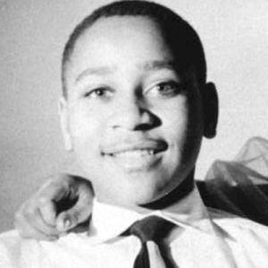
The Murder of
Emmitt Till

Slide 2
The Beginnings of the Civil Rights Movement in America
1954
May 17 In Brown v. Board of Education, the Supreme Court declares that segregated schools are inherently unequal and thus unconstitutional
1955
Aug. 28 Emmett Till, a black boy from Chicago visiting his uncle Moses Wright in Mississippi, is murdered for inappropriately addressing a white woman
Sep. 23 Two white men are tried in the murder of Emmett Till but are quickly acquitted
Dec. 1 Rosa Parks is arrested in Montgomery, Alabama for refusing to relinquish her seat in the front of the bus to a white person
Dec. 5 King leads the blacks of Montgomery in a rally to boycott city buses. In response to the blacks’ bus boycott, many whites join White Citizens’ Councils to uphold segregation and white control of the region
1956
Nov. 13 The Supreme Court rules that segregation on buses in Montgomery is against the law
Dec. 21 The Supreme Court rules that segregation on Montgomery buses is illegal and the boycott ends

Slide 3
Life in Mississippi for Blacks

Slide 4
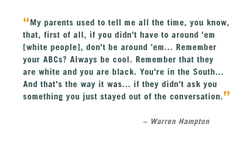

Slide 6
Lynchings
An act of terror meant to spread fear among blacks with the purpose of maintaining white supremacy
Lynchings were frequently committed with the most flagrant public display. Like executions by guillotine in medieval times, lynchings were often advertised in newspapers and drew large crowds of white families. They were a kind of vigilantism where Southern white men saw themselves as protectors of their way of life and their white women.

Slide 7
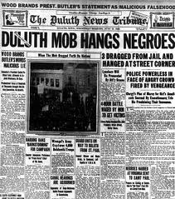

Slide 8
Most infractions were for petty crimes, like theft, but the biggest one of all was looking at or associating with white women. Also, many victims were black businessmen or black men who refused to back down from a fight.
From the 1800’s until the 1950’s, there were nearly 5000 lynchings in the US. Today we will be looking at one specific example of a lynching that set off a national reaction and helped start the civil rights movement.

Slide 9
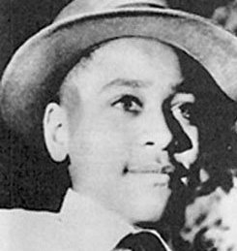
Background
Emmitt Till was a 14 year old boy from Chicago who went to visit his aunt and uncle in Mississippi in 1955. When he arrived, racial tensions were reaching a boiling point. Till, who grew up in the North, did not understand the strictness of racial “rules” nor did he recognize the risks involved in violating them.

Slide 10
While Emmitt was in Mississippi, he offended a white woman which angered two white men. They kidnapped and eventually killed him.
Till’s mother insisted on an open casket at her son’s funeral.
The two men were acquitted and found not guilty during their trial.
A short time later, they admitted their guilt and explained why they killed Till. Despite this, there were no consequences for the murder.

Slide 11
Now watch the video excerpt on Emmitt Till from “Eyes on the Prize.”
https://www.youtube.com/watch?v=PxK8u58PqTE

Slide 12
Discussion Questions
Why do you think Till’s actions toward Carolyn Bryant sparked such violence?
Curtis Jones was playing checkers with an older man who warned him that Bryant was likely to react violently to Till’s comments. What did he know that Till did not? How do people learn the rules and customs of a society?
What is the role of intimidation, lynching and fear in a segregated society?

Slide 13
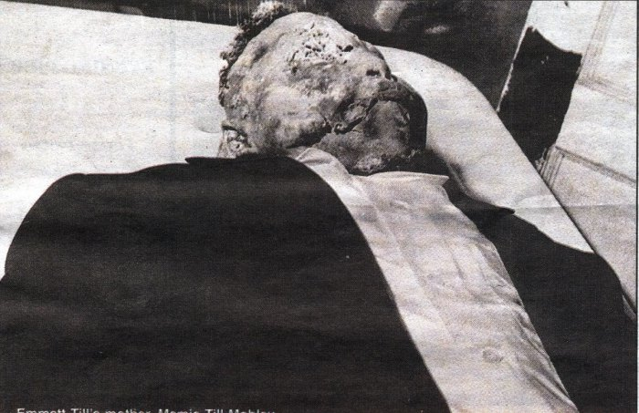
Why do you think Emmitt’s mother decided to show the public her son’s mutilated body?
Why do you think the mainstream press was reluctant to publish the photos?

Slide 14
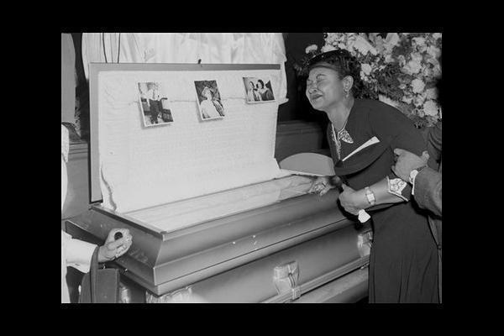
What role can the press play in exposing injustice?
Are there news stories that have led you to express outrage or influence you to take action?

Slide 15
The Trial
Why were black Americans afraid to testify against whites in the South? What does their fear reveal about justice in the South at that time?
What in your opinion compelled Emmitt’s uncle, who knew the dangers of speaking out, to step up and testify against the murderers?
How did his actions make him a symbol of the Civil Rights movement?

